Slide 1
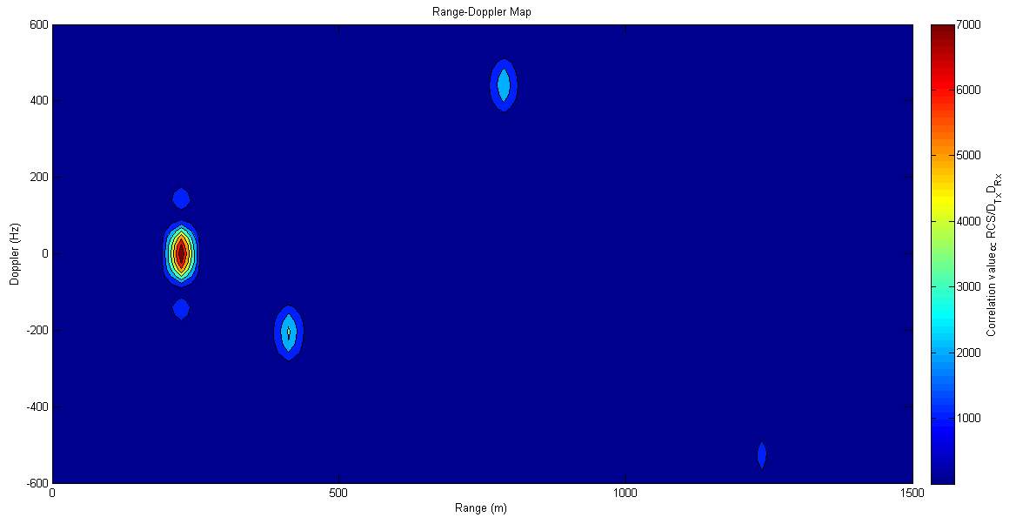
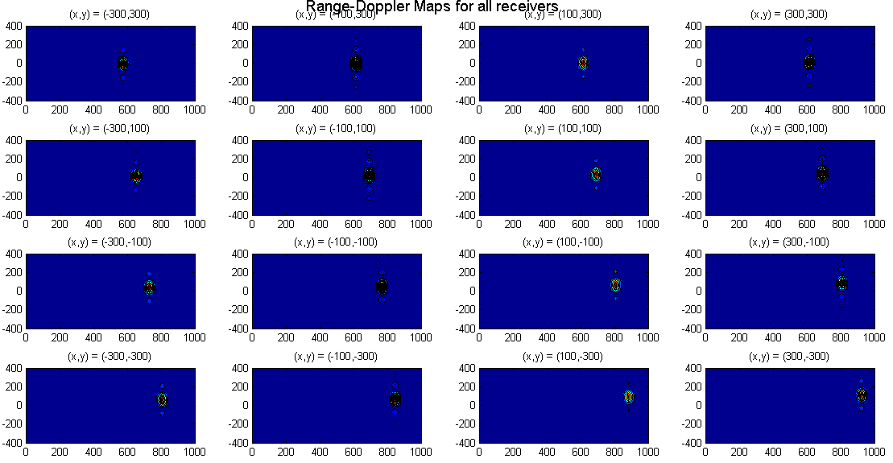
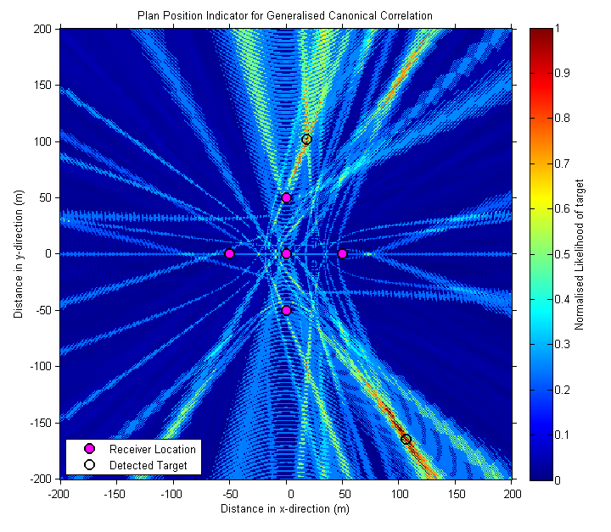
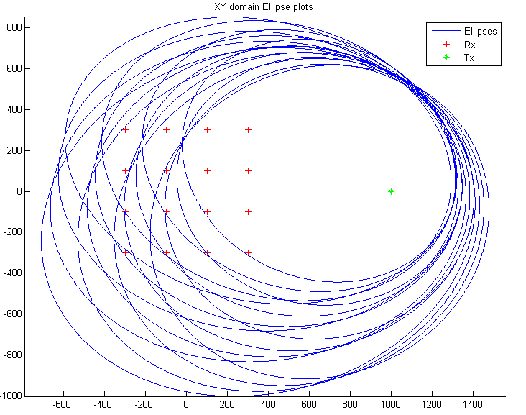
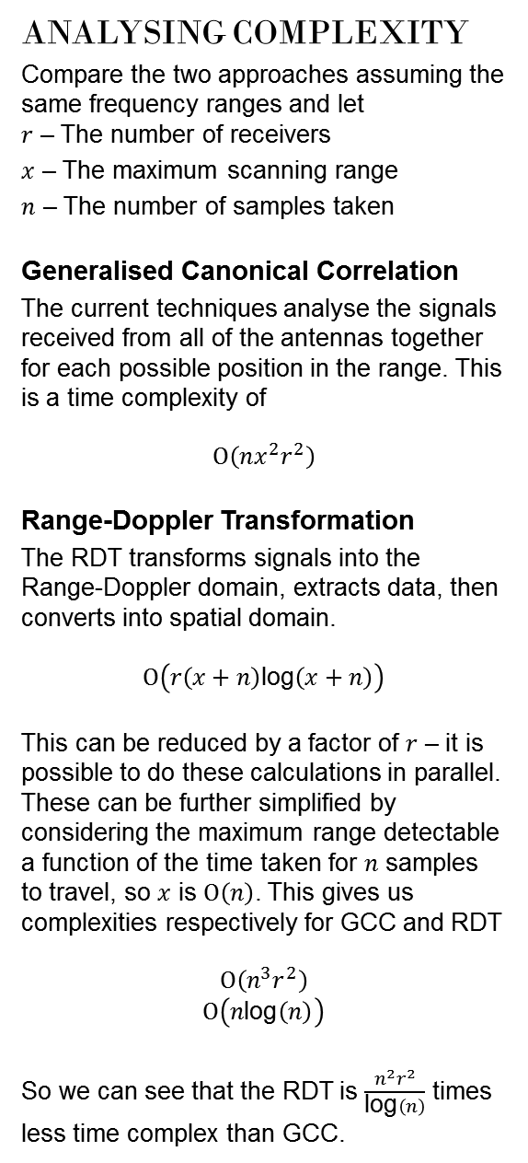
Passive Radar Detection
Lewis Chambers & Vaughan Clarkson
OVERVIEW
Passive radar detection is the problem of locating unknown targets using only static radar receivers. It uses unknown signals broadcast by non-cooperative parties.
Advantages over active radar
Covert, anti-stealth, immune to electronic counter measures (jamming)
Cheap (No need for transmitter)
Green (Less energy required to run)
CURRENT METHODS
Generalised Canonical Correlation Current methods such as GCC analyse all receivers together. They perform a likelihood calculation for each possible position of targets.
This results in a Plan Position Indicator (PPI) display of likelihoods of targets
NEW TECHNIQUE
Motivation
Antennas are much cheaper
Plausible to have large numbers of receivers for a detection system
Need a detection scheme that can analyse multiple inputs simultaneously
Range-Doppler Map
RD maps can facilitate these requirements. Received signal is correlated with itself at each receiver. Gives a measure of how likely a target is to be at a certain range (difference between the Tx-Rx and the Tx-Target-Rx paths) or frequency (velocity).
Range-Doppler Transformation
Each target in the RD map represents an ellipse with foci at the Rx and Tx locations.
Find all ellipses for all receivers
Intersect ellipses and vote
Intersection point with highest consensus is a target
Remove target ellipses and repeat consensus step until threshold reached
ANALYSING COMPLEXITY
Compare the two approaches assuming the same frequency ranges and let $r$ – The number of receivers
$x$ – The maximum scanning range
$n$ – The number of samples taken
Generalised Canonical Correlation
The current techniques analyse the signals received from all of the antennas together for each possible position in the range. This is a time complexity of
$$Ο\left(nx^{2}r^{2}\right)$$
Range-Doppler Transformation
The RDT transforms signals into the Range-Doppler domain, extracts data, then converts into spatial domain.
$$Ο\left(r\left(x+n\right)\text{log}\left(x+n\right)\right)$$
This can be reduced by a factor of $r$ – it is possible to do these calculations in parallel. These can be further simplified by considering the maximum range detectable a function of the time taken for $n$ samples to travel, so $x$ is $Ο\left(n\right)$. This gives us complexities respectively for GCC and RDT
$$Ο\left(n^{3}r^{2}\right)$$
$$Ο\left(n\text{log}\left(n\right)\right)$$
So we can see that the RDT is $\frac{n^{2}r^{2}}{\text{log}\left(n\right)}$ times less time complex than GCC.
FUNCTIONALITY
Sidelobes in RD map due to ambiguity function in range and Doppler
Targets located in different spatial positions but at same range
Timing and synchronisation issues become less prevalent and amount of computation decreases
EXAMPLE SIMULATION
A single transmitter located at (1000,0)
A receiver array centered around (0,0)
Simulated a single target at (1100,500) with velocity of (200,-200)
Determined that there is 1 target located at (1078, 519).
Error of 29m.
8MHz sampling means 37.5m covered between samples

